Slide 1
Introducing Trade, Teacher’s & Staff

Slide 2
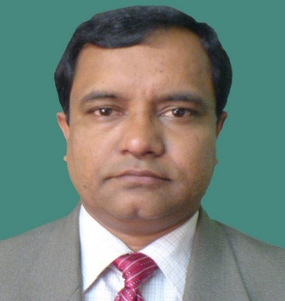
Santush Chandra Debnath
Principal
Sylhet Technical School And College.
Mob: 01552438664

Slide 3
Automotive Department
Md.Habibir Rahman
Junior Instructor(Auto)
Mob:01717769038
Md. Abdul Baten
Guest Teacher(Auto)
Mob:01739980528
Md. Jahangir Alom
Guest Teacher(Auto)
Mob:01733274884
Muhammod Rasel Dali
Workshop Khalasi (Auto)
Mob : 01744240843

Slide 4
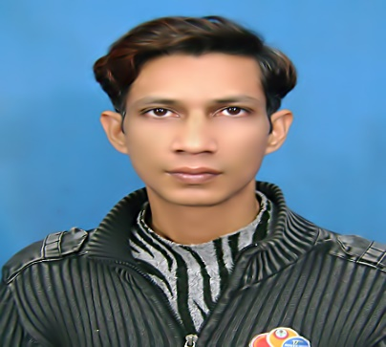
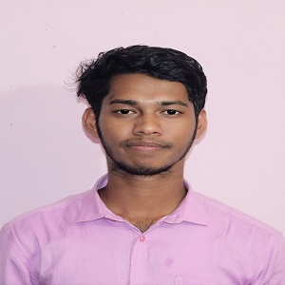
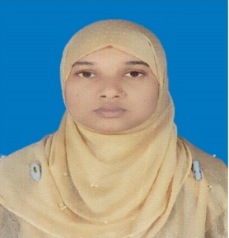
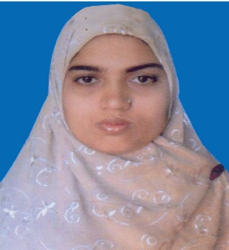
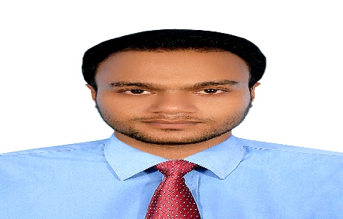
Computer Department
Md. Mahibar Rahman Khan
Junior Instructor (Computer)
Mob: 01715546254
Mr. Asish Sarkar
Guest Teacher (Computer)
Mob : 01776586611
Taslima
Workshop Khalashi
Mob: 01946761323
Sonia Afroz
Part Time Teacher (Computer)
Mob :01679203623
Md. Sheikh Toimur
Guest Teacher (Computer)
Mob :01718656193

Slide 5
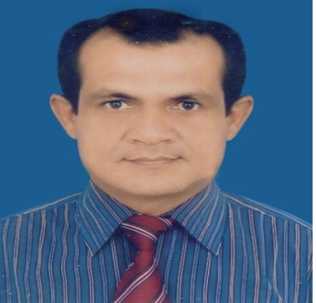
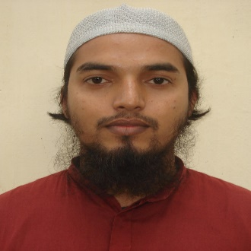
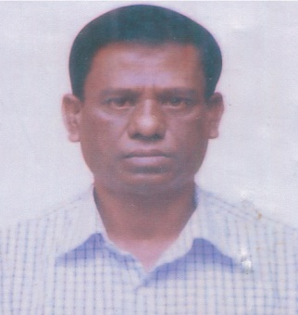
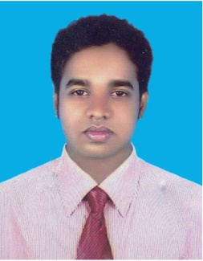
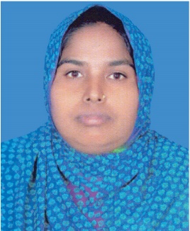
Drafting Civil Department
Abdul Halim Mia
Junior Instructor (DC)
Mob: 01712790004
Md.Rofiqul Islam
Junior Instructor (DC)
Mob : 01712733994
Prodip Kumar Ray
Trade Instructor (DC)
Mob: 01712565515
Md.Al Amin Vuia
TRA (DC)
Mob :01831872537
Mst. Rehena Khatun
Workshop khalashi (DC)
Mob : 01753540517

Slide 6
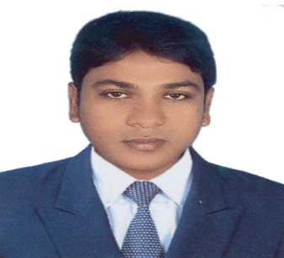
Electrical Department
Santush Chandra Debnath
Chief Instructor (Electrical)
Mob: 01552438664
Asim Chokroborty
Junior Instructor (Electrical)
Mob: 01712109640
Dipul Gusami
Part TimeTeacher (Electrical)
Mob:01717721748
Md.Hasan Mia
TRA (Electrical)
Mob : 01917300532

Slide 7
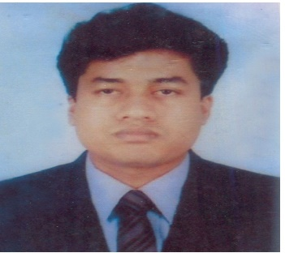
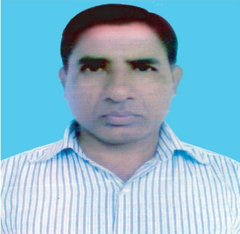
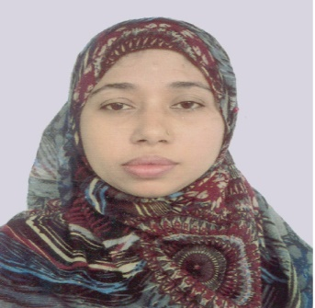
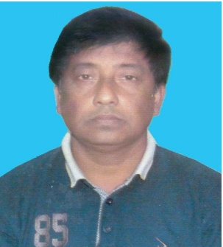
Electronics Department
Nihar Ronjon Ray
Junior Instructor(R/Tv)
Mob: 01712254150
Kazi Md. Abdul Salam
Senior Trade Instructor(R/TV)
Mob :01552426865
Sudipto Chokroborti
Junior Instructor(R/TV)
Mob :01720934673
Rubina Begum
Part TimeTeacher (R/Tv)
Mob:01717644981
Md. Gulam Faruq Ahmed
TRA (R/TV)
Mob : 01710904502

Slide 8
Farm Mechinary Department
Md.Mahbub Hasan
Junior Instructor(Farm)
Mob: 0171702162
Uzzwal Kumar Dey
Junior Instructor(Farm)
Mob :01717908128
Al Helen Akhi
Guest Teacher(Farm)
Mob:01953191299

Slide 9
Machine Tools Operation Department
Aurun Kanti Shorma
Junior Instructor (Machinist)
Mob: 01818842025
Md.Sofiqul Islam
Senior Craft Instr.(Machinist)
Mob: 01913256514
Lutfur Rahman
Part Time Teacher(Machinist)
Mob : 01911940528
Sofiqur Rahman
Workshop Khalashi (Machinist)
Mob : 01515268712

Slide 10
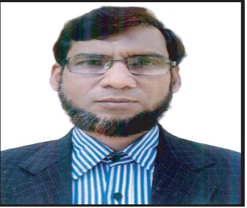
RAC Department
Eng. Md. Siddikur Rahman
Chief Instructor (RAC)
Mob:01743339923
Md.Abu Ahmed
Junior Instructor(RAC)
Mob: 01816734186
Md.Sahab Uddin Loskor
Sinior Trade Instructor(RAC)
Mob :01716989218
Monirul Haque
Workshop Khalashi (RAC)
Mob : 01923701787

Slide 11
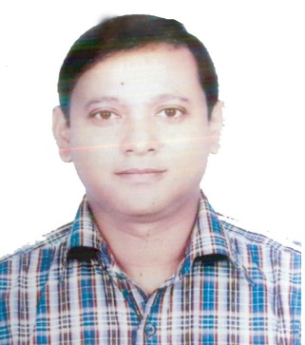
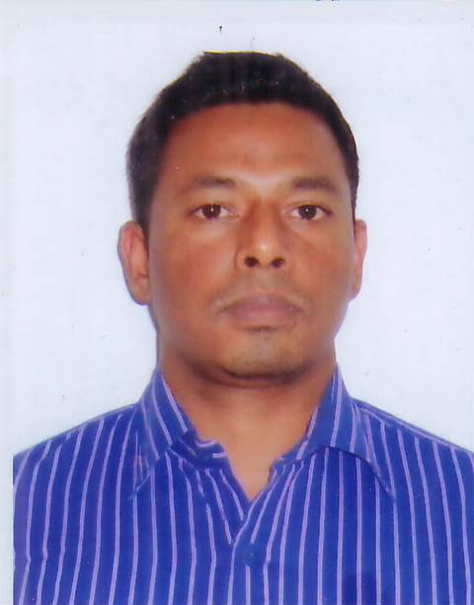
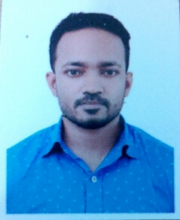
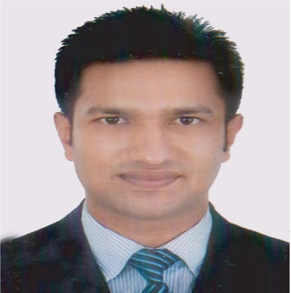
Welding And Fabrication Department
Bishwajit Dash
Chief Instructor (Welding)
Mob: 01711203810
Ratan Kumar Sen
Instructor (Welding)
Mob :01756251002
Shahed Miah
Guest Teacher (Welding)
Mob: 01722616521
Md Saddam Hussain
TRA (Welding)
Mob : 01923701787

Slide 12
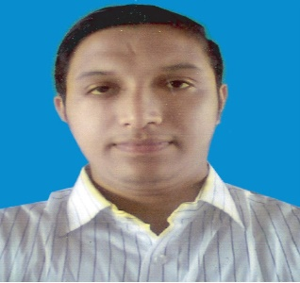
Wood Working Department
Mohammod Azharul Islam
Chief Instructor (Carpentry)
Mob: 01723210577
Md.Nadim Husen
TRA (Carpentry)
Mob :01729671899
Juma Begum
Guest Teacher (Carpentry)
Mob: 01689477390
Rois Uddim
Workshop Khalashi (Carpentry)
Mob :01734906616

Slide 13
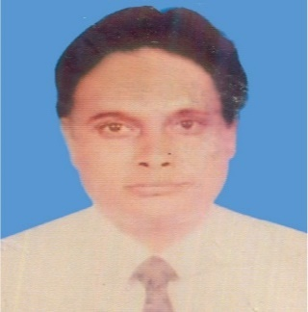
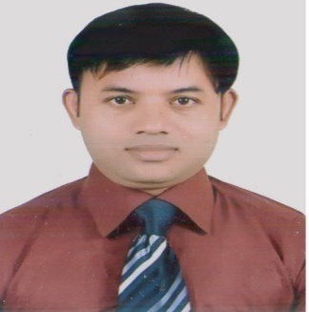
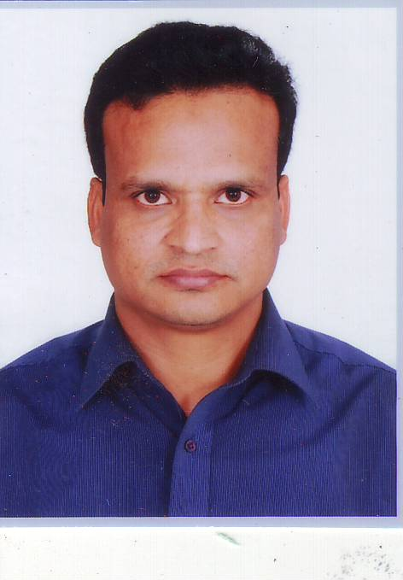
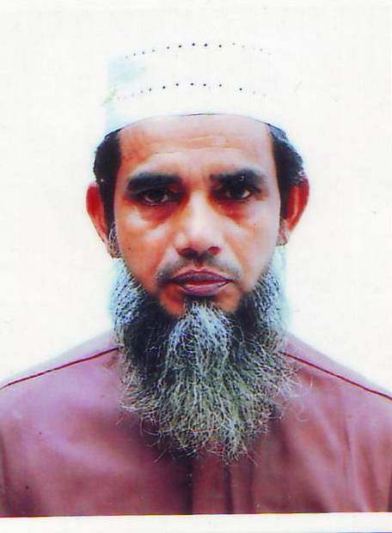
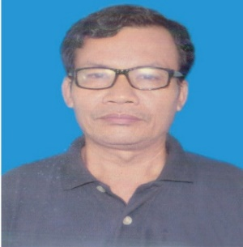
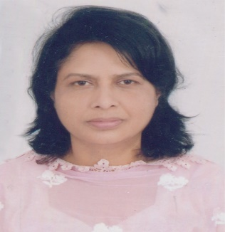
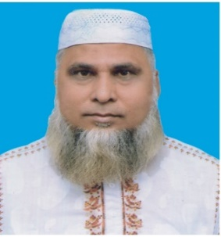
RS Department
Muhammod Ibrahim Kholil Instructor(Physics)
Mob: 01712254150
Dhananjoy Chandra Roy
Instructor(Math)
Mob: 01712254150
Muhammad Abdul Bari
Instructor(Math)
Mob:01712909086
Momtaz Ali
Math/Science Teacher
Mob:0152428059
Kunjeshor Singho
Senior Science Instructor
Mob:01677134611
Nurun Nahar
Language Teacher
Mob:01518301186
Muhammod Asraful Islam
Religion Islam Teacher
Mob: 01715164896

Slide 14
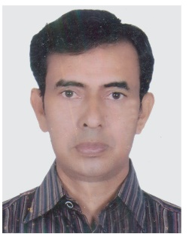
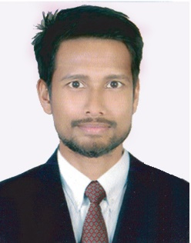
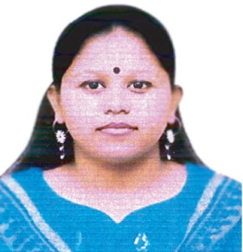
RS Department
Md.Abdur Rob
Part Time Teacher
Mob:01712661040
Nasir Mia
Guest Teacher
Mob: 01688221832
Onurada Ray
Guest Teacher
Mob: 01792247605

Slide 15
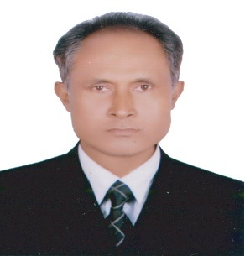
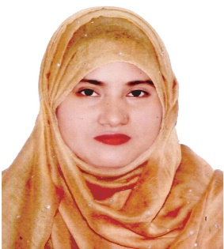
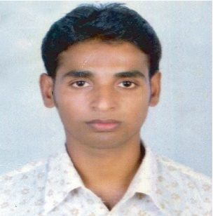
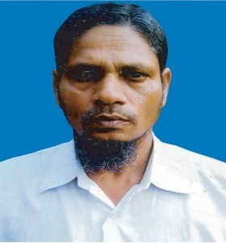
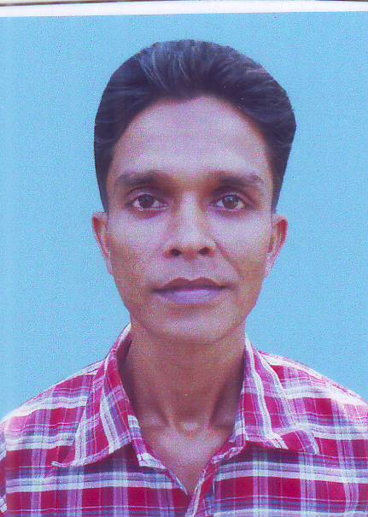
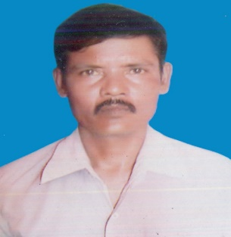
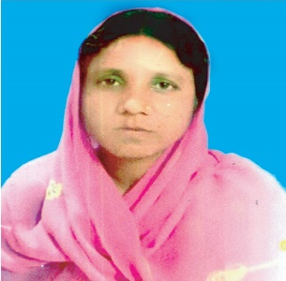
Office Staff
Amir Hussen
Cash Sorkar
Mob:01712825316
Fatema Begum
Office Attended(Com)
Mob: 01770448078
Poritush Baidya
Workshop Khalashi
Mob:01715161694
Md. Hanifur Rahman
Office Attended
Mob:01814496158
Md.Alauddin
Workshop Khalashi
Mob:01760876661
Mihir Chondro dash
Security Guard
Mob:01779878172
Shikha Rani
Aiya
Mob:01786248461

